Slide 1
Cloud Security
ENPM665
Kevin shivers

Slide 2
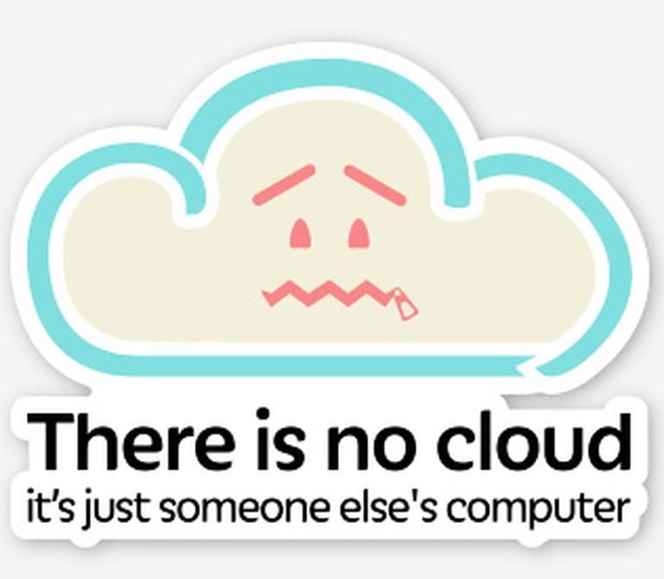

Slide 3

Who am I?
Deputy CISO - Division of IT, UMD
Runs UMD’s Security Operations (SOC, Engineering, Consulting)
Not a doctor (but I have played one for a pen-test)
18+ years of experience in InfoSec
Alum of Sourcefire and McAfee

Slide 4
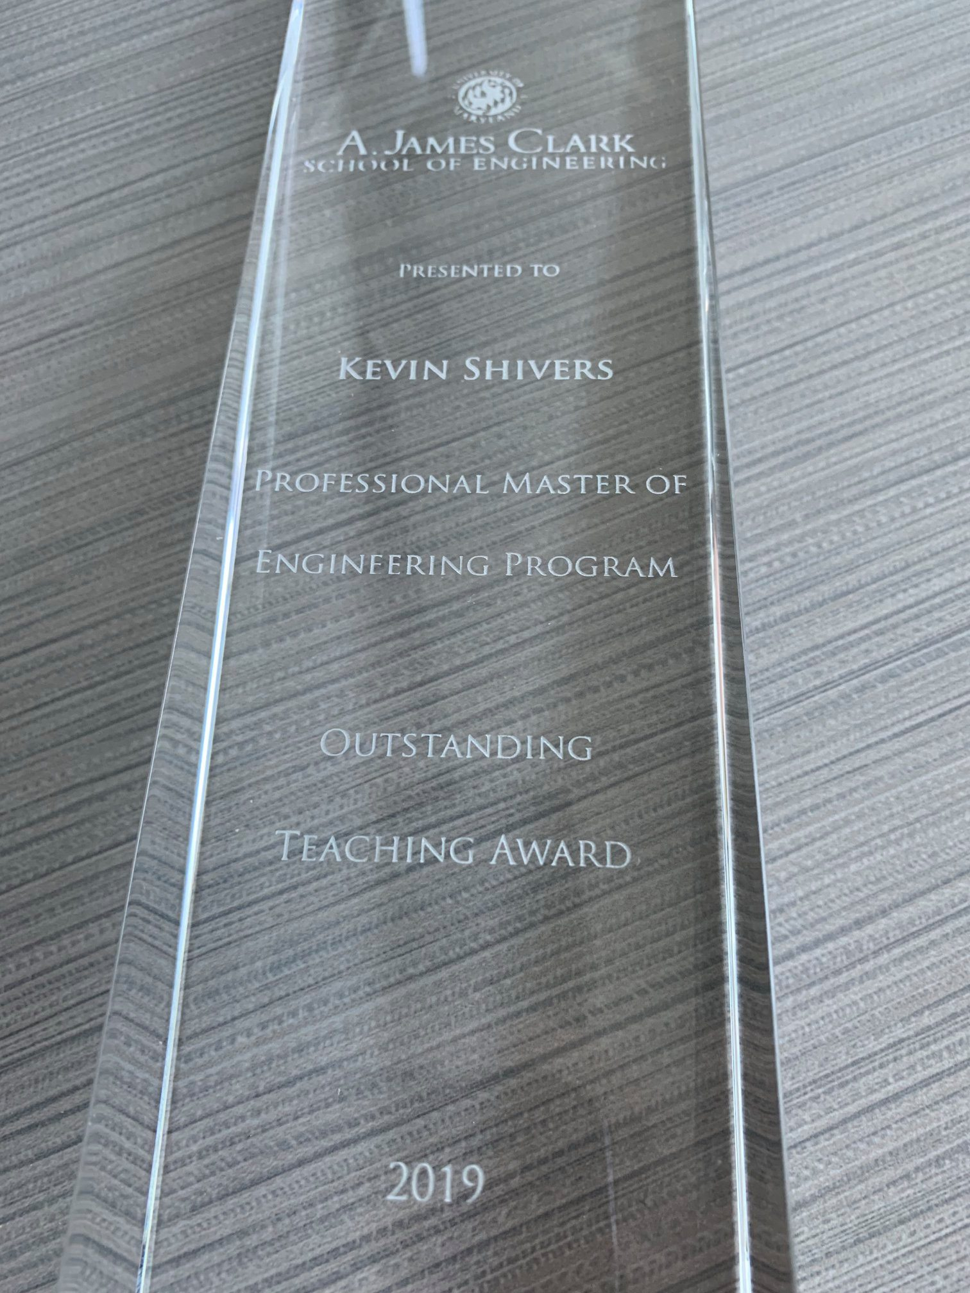
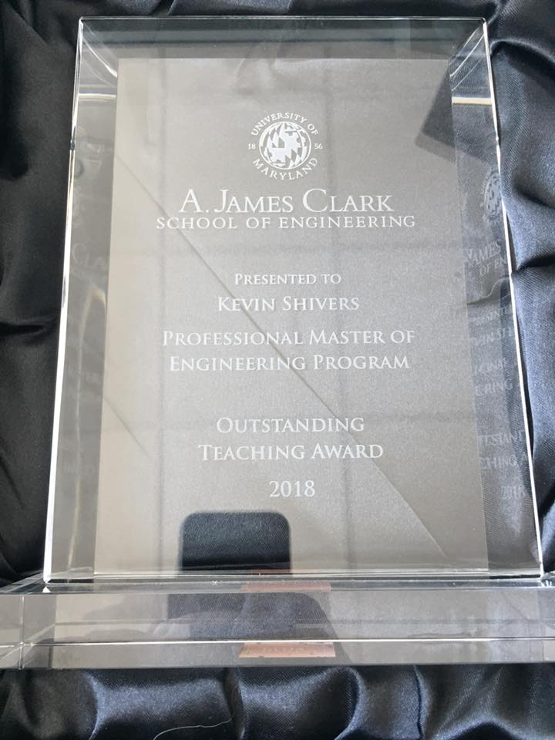
#humblebrag

Slide 5
TA
Derek Zhang
dzhang21@umd.edu
Office Hours: Tuesday & Thursday 5:30 – 7pm and by appointment (all via Zoom)

Slide 6
Note
I do not have any open TA/GA/grader/student employee positions at this time.
If and when I do they will be posted on MAGE’s website and/or I will post about them in ELMS.

Slide 7
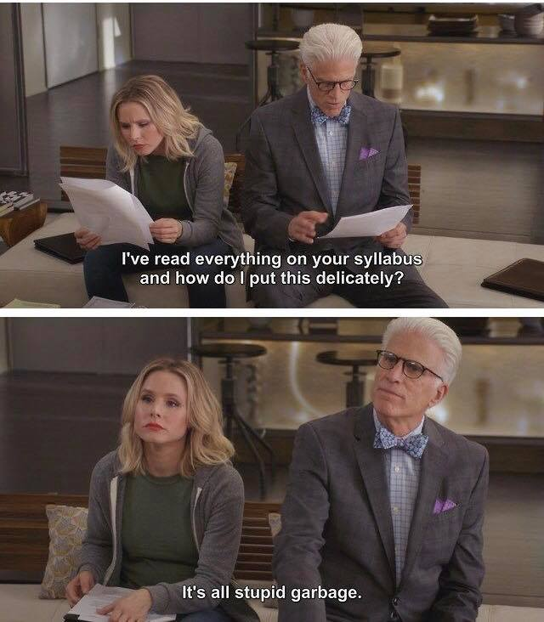

Slide 8
Course schedule
Wednesday 4pm – 6:40pm
August 31st – December 7th

Slide 9
For those playing the home game…
Have the slides as the primary focus when watching live/on demand recordings.

Slide 10
Attendance
You MUST attend the section you are enrolled in and can NOT attend other sections.
Ex: CY01 section can not attend in person (0101, 0201, or 0301)
Ex: 0101 and 0301 sections can not attend 0201.

Slide 11
Attendance
I am not planning to take attendance.
Note for students in section 0201 on an F1 visa, your visa status may be in jeopardy if you do not attend in person. For students on an F1 visa I look forward to seeing you each and every week. 🤗

Slide 12
Office Hours
Mondays – 11:30am – 1pm
Also by appointment (online)
via Zoom link in ELMS

Slide 13
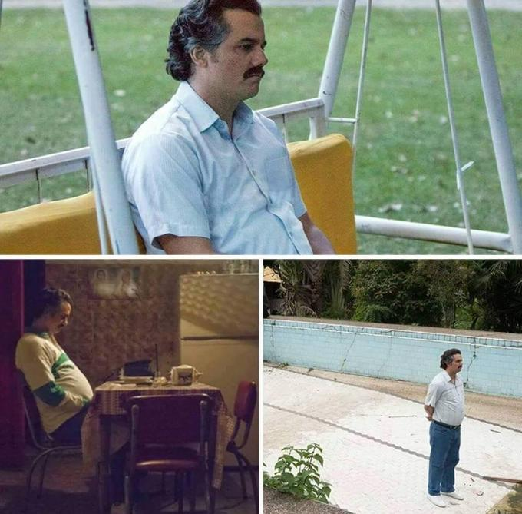

Slide 14
Contact Info
kts@umd.edu - Best way to reach me. Please put “ENPM665” in the subject line so it doesn’t get lost in the mess that is my inbox

Slide 15
Course Numbering Note
Until recently the course was numbered ENPM809J, you may still see some references to that course number in the course content
ENPM809J = ENPM665

Slide 16
Grading
Homework = 40% (5 assignments, 8% each)
Midterm Project = 30%
Final Project = 30%

Slide 17
+/- Grading
It’s University Policy (if a little silly)
Review the syllabus for the break down between the various grade levels.

Slide 18
Grading
Do the work and you’ll do fine.
If you don’t understand something or have concerns speak up/reach out as soon as possible!

Slide 19
Late Assignment Policy
Late assignments will have 10% of the points deducted for every day the assignment is late.
ex. You turn in a “10” it gets a “9”
Assignments submitted over one week late will not be accepted or graded.
aka you get a zero.
If there are extenuating circumstances for you to submit work late please contact me as soon as possible (preferably before the assignment is due.)

Slide 20
Late Assignment Policy
An assignment is not complete until it has been submitted in ELMS.

Slide 21
Late Assignment Policy
Check that you submitted the correct assignment after you have uploaded it!

Slide 22
Late Assignment Policy
The only timestamp that matters is the one in ELMS

Slide 23
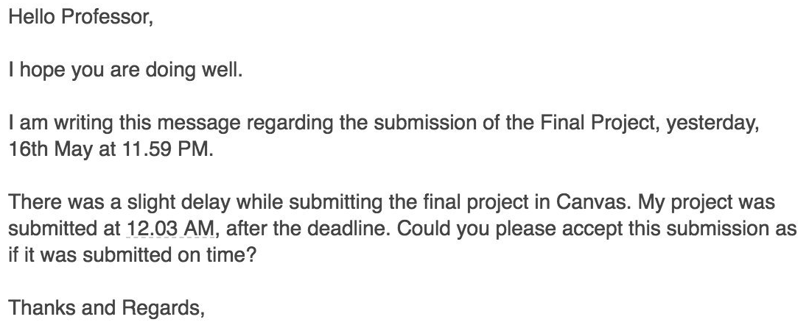
LATE IS LATE

Slide 24
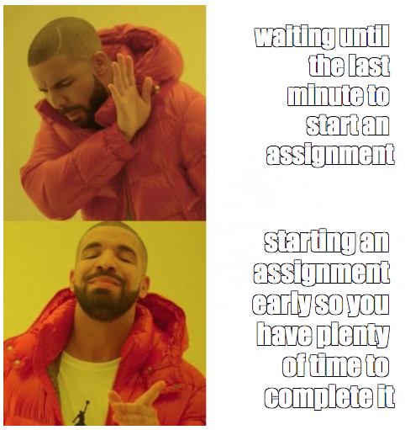

Slide 25
Grade Disputes
I have on (rare) occasions been known to make mistakes.
If you spot an mistake in your grades then contact me and we’ll get it resolved.
Note that if I review an assignment for grading mistakes I will conduct a complete regrade, your resulting grade may be higher or lower.

Slide 26
Notice
If you didn’t do the assignment, admit it.
If you submitted the assignment late, admit it.
If you don’t understand the assignment, ask for help.
If you didn’t study or put any effort into the assignment accept the grade and resolve to do better (with my help if needed) next time

Slide 27
Homework
There are 5 homework assignments.
Due dates for the homework are in the syllabus.

Slide 28
Midterm and Final Projects
This class has a projects vs exams.
Treat the midterm as if you are presenting it to a
C-level technical executive. (CIO, CISO, CTO, …)
Treat the final as if you are presenting it to senior level technical staff member (security architect, system architect, …)

Slide 29
Academic Integrity
The University of Maryland, College Park has a nationally recognized Code of Academic Integrity. This Code sets standards for academic integrity at Maryland for all undergraduate and graduate students. As a student you are responsible for upholding these standards for this course. It is very important for you to be aware of the consequences of cheating, fabrication, facilitation, and plagiarism. For more information on the Code of Academic Integrity or the Student Honor Council, please visit https://studentconduct.umd.edu/

Slide 30
Honor Pledge
All assignments and exams for this course are governed by the Honor Pledge: “I pledge on my honor that I have not given or received any unauthorized assistance on this exam/assignment.”

Slide 31
Plagiarism
DON’T
DO
IT

Slide 32
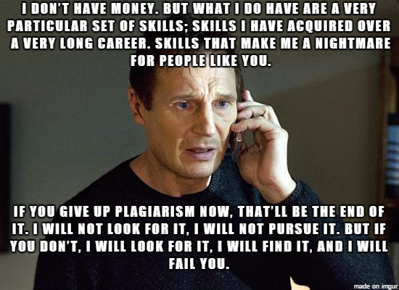

Slide 33
Asking for help
Asking a fellow student for help understanding a concept is OK
Asking a student to help you with an answer to a homework assignment or project IS NOT OK.
If you are asked for answers to an assignment DO NOT provide them.
If you need help with a concept or how to do something ASK!
Email the TA or the instructor
Attend office hours (virtually or in person)

Slide 34
Plagiarism. Don’t do it.
The practice of taking someone else's work or ideas and passing them off as one's own.
This includes getting a friend/classmate to give you the answers to an assignment and using them.
Helpful infographic: http://thevisualcommunicationguy.com/wp-content/uploads/2014/09/Infographic_Did-I-Plagiarize1.jpg
If I see it you will get a 0 for the assignment and at my discretion will be reported to the Office of Student Conduct.
Seriously.
Don’t be that person.
Seriously.

Slide 35
Which one is correct?
ip address
IP address
Ip address
I.p. address
I.P. address

Slide 36
PROOFREAD YOUR WORK
If I find typos or egregious grammatical errors in your work I will subtract points.

Slide 37
PROOFREAD YOUR WORK
I am preparing you for taking the next step in the real world and part of that is projecting that you know what you are talking about.
Typos and egregious grammatical errors do not inspire competence.

Slide 38
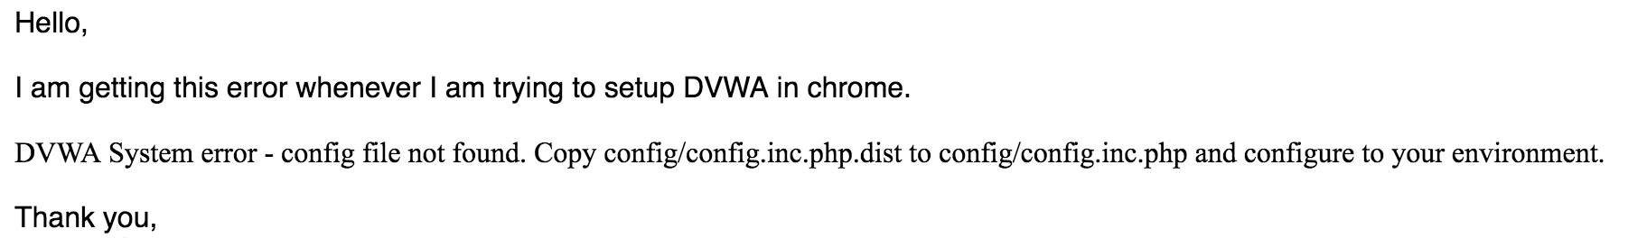
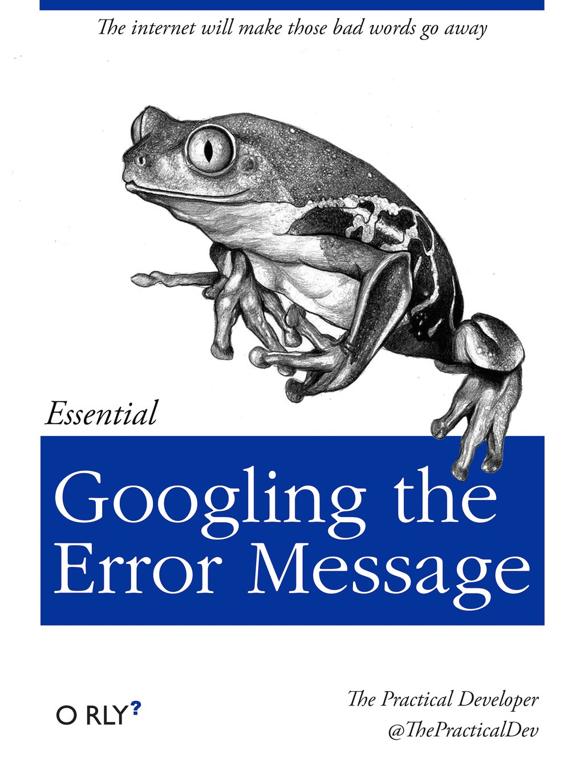
Troubleshooting

Slide 39
Course Layout
August 31st – Introduction & Administrivia
Sept 7th – Securing the Cloud
Sept 14th – Designing and Redesigning Secure Applications for the Cloud
Sept 21st – Identity and Access Management
Sept 28th – Protecting Data in the Cloud

Slide 40
Course Layout
6. October 5th – Compliance in the Cloud
7. October 12th - Deep Dive – AWS
8. October 19th – NO CLASS WORK ON MIDTERM
9. October 26th – Deep Dive – Azure
10. November 2nd – Deep Dive - Google Cloud

Slide 41
Course Layout
10. November 9th – Incident Response
11. November 16th - Vulnerability Scanning and Pen Testing in the Cloud
12. November 23rd – THANKSGIVING BREAK
13. November 30th – Securing SaaS
14. December 7th - Course Wrap up

Slide 42
Feedback is a Gift
Please let me know if you find something lacking or have specific tools you’d like to see included.
Don’t be afraid to share your honest opinion
Feedback should be specific
Feedback should be descriptive
Feedback should be timely

Slide 43
Class Requirements
A computer with a web browser, command prompt, and Internet access.
An AWS account
The AWS CLI tool
An Azure account

Slide 44
Set aside $50
The work we do during the in class exercises, homework, and projects should be able to be done in the free tiers of AWS, Azure and Google.
That said you should set aside $50 for potential overages.
ALWAYS SHUT OFF CLOUD SERVICES WHEN DONE!

Slide 45
CCSP
Certified Cloud Security Professional
This class is not a CCSP-prep class, but the class material is aligned with it.

Slide 46
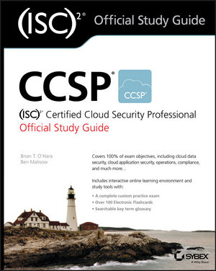
CCSP Book
(ISC²) Official Study Guide
O’Hara, B. & Malisow, B. CCSP (ISC)2 Certified Cloud Security Professional Official Study Guide 2nd edition Sybex, 2019. ISBN: 978-1119603375

Slide 47
Technical Issues
With ELMS: elms@umd.edu
With the recorded lectures: dets-support@umd.edu or http://www.dets.umd.edu/
Tools discussed in class:
Google
AWS/Azure/GCP documentation
Email the TA
Email the Professor

Slide 48
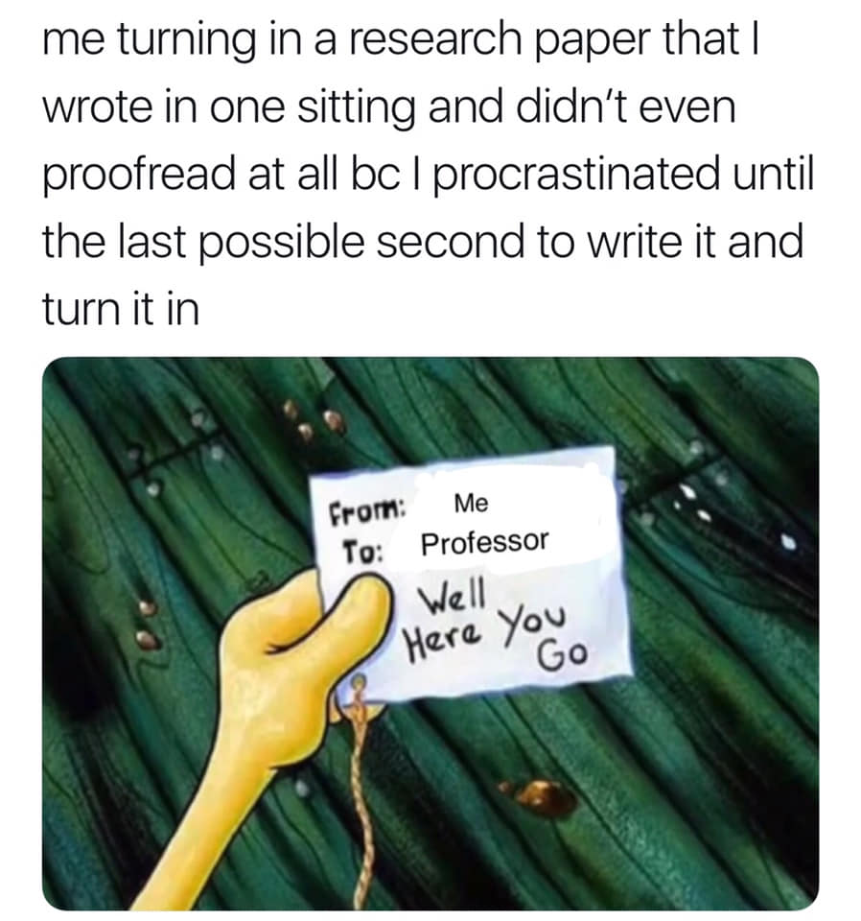
Time Management 101

Slide 49
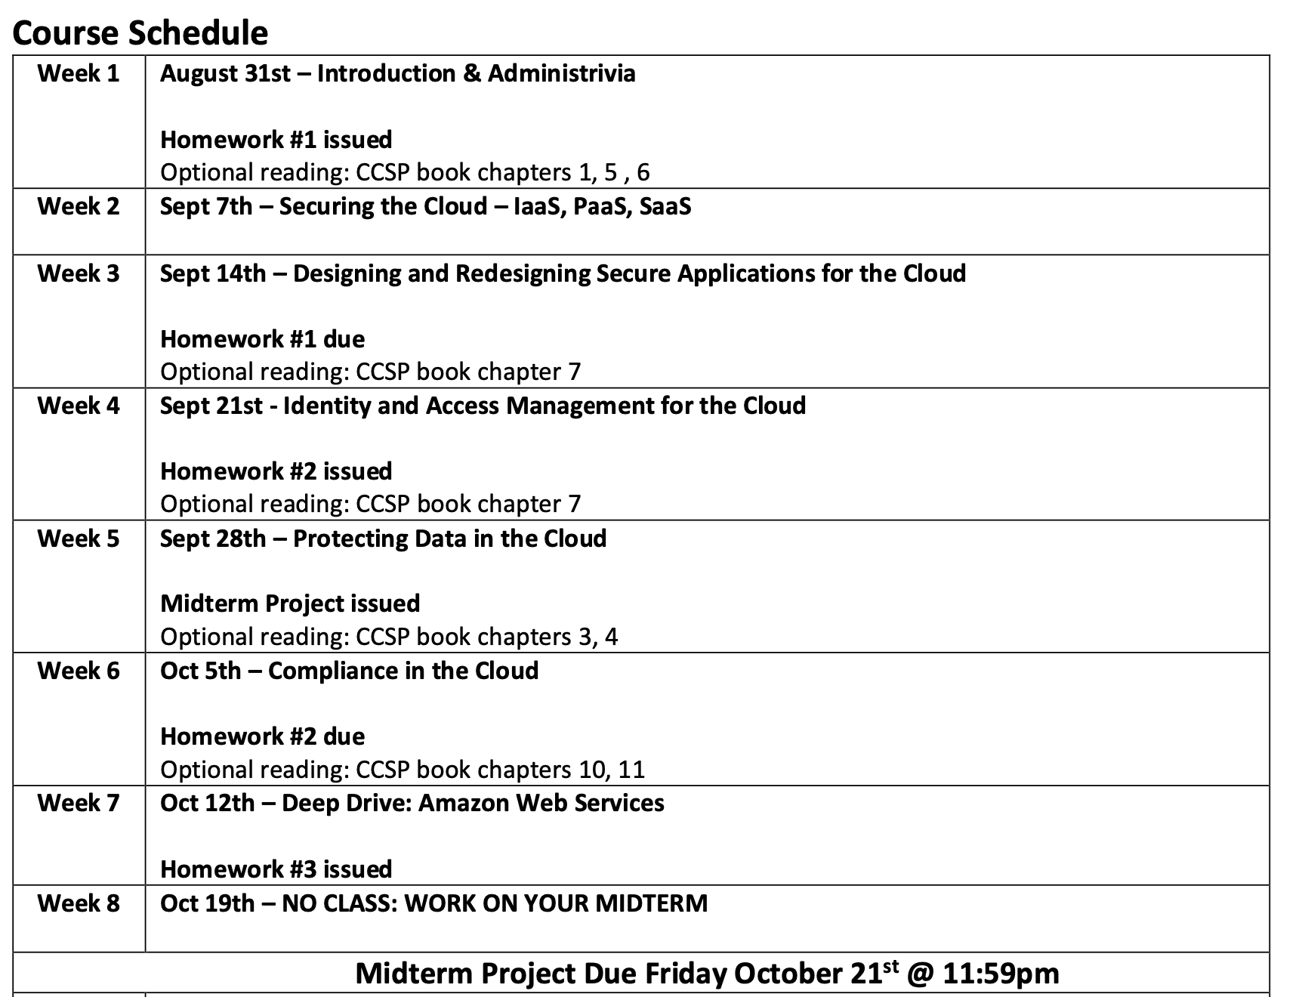

Slide 50
Build your calendar
9/14 – HW #1 due
10/5 – HW #2 due
10/21 – Midterm due
11/2 – HW #3 due
11/16 – HW #4 due
11/20 – HW #5 due
12/16 – Final due

Slide 51
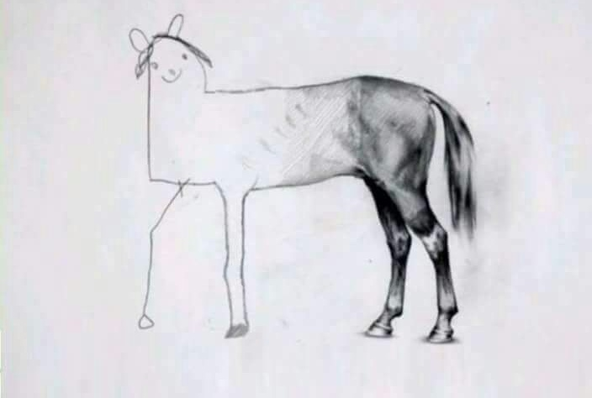
Don’t let your assignments look like this

Slide 52
You have at least 2 weeks to complete an assignment
Night of – review the assignment – how much time will this take me? The professor has included a time estimate, how close is that for me?
Day after class – begin/complete assignment
2 Nights before it’s due – review/upload assignment

Slide 53
How I’d do a project
Midterm assigned 9/28
Review and begin work 9/29 – 9/30
Develop outline
Draft complete 10/5 – 10/18
Completed, night off for review 10/19
Review & Submit midterm – 10/20
Midterm due 10/21 @ 11:59pm

Slide 54
Why?
Completed, night off for review 10/19
Review & Submit midterm – 10/20
Midterm due 10/21 @ 11:59pm
Why?

Slide 55
Every semester
Review the syllabi for your classes for assignments, exams, projects, etc. and put them on your calendar!
If a syllabus doesn’t list assignments/dates then ask the professor!

Slide 56
So what is
“the cloud”?

Slide 58
What is the Cloud?
Essentially someone else’s computer that you lease from them.

Slide 59
What is the Cloud?
Essentially someone else’s computer virtual machine that you lease from them.

Slide 60
What is the Cloud?
Essentially someone else’s computer virtual machine infrastructure that you lease from them.

Slide 61
What is the Cloud?
Essentially someone else’s computer virtual machine elastic infrastructure that you lease from them.

Slide 62
NIST 800-145 Definition of Cloud
“Cloud Computing is a model for enabling ubiquitous, convenient, on-demand network access to a shared pool of configurable computing resources (e.g. networks, servers, storage, applications, and services) that can be rapidly provisioned and released with minimal management effort or service provider interaction.”
http://nvlpubs.nist.gov/nistpubs/Legacy/SP/nistspecialpublication800-145.pdf

Slide 63
In the 90s/00s…
We had web hosting companies and application hosting companies.
“Why build a data center when we can do it for you?”
But the ASP still had to provision hardware and spin it up…

Slide 64
ASP + API = Cloud
Let’s add an API (and UI) to application service providers and make ALL THE MONEY.
Click button, get server.
Add elasticity so you can scale up and down on demand and only pay for what you use.

Slide 65
Everything as a Service
Software as a Service (think Google Apps, Salesforce, Box)
Platform as a Service (think Salesforce, AWS Elastic Beanstalk)
You manage the application, provider manages the underlying infrastructure.)
Infrastructure as a Service (think AWS, Azure, Google Cloud Platform)

Slide 66
5 attributes of cloud computing
Multitenancy - You’re sharing the real hardware with many other people/companies
Elasticity - Need 5 systems or 5 Million systems? We got that
Pay as you go - No long term contracts* or capital expenses
Self-provisioning of resources - Click button, get server
Massive scalability - You get a data center in VA, you get a data center in Europe, you get a data center in Singapore…

Slide 67
Software-as-a-Service
Instead of buying a software package you lease it, pay as you go.
This puts it as an operating expense and not a capital expense.
CIOs and money people like that.

Slide 68
Other benefits
(In theory) Save on expenses of
Licensing
Servers
Storage
Network Infrastructure
People to manage system

Slide 69
Platform-as-a-Service
You are given a development platform to build applications on top of
Typically provided toolkits and standards for development and then the sky is the limit.
Think Salesforce

Slide 70
Salesforce
Started as an SaaS customer relationship management tool (because in house ones are $$$ and often fail to be implemented successfully.)
Expanded to offer a full suite of apps like Support/Trouble ticketing, HR issues, performance improvement/coaching, and tons more.
Plus anyone can write an app that runs on Salesforce.

Slide 71
Infrastructure-as-a-Service
Essentially a vendor provides you with virtual systems that you can install any software, OS, etc. you want and do with it as you please (within the Terms of Service)

Slide 72
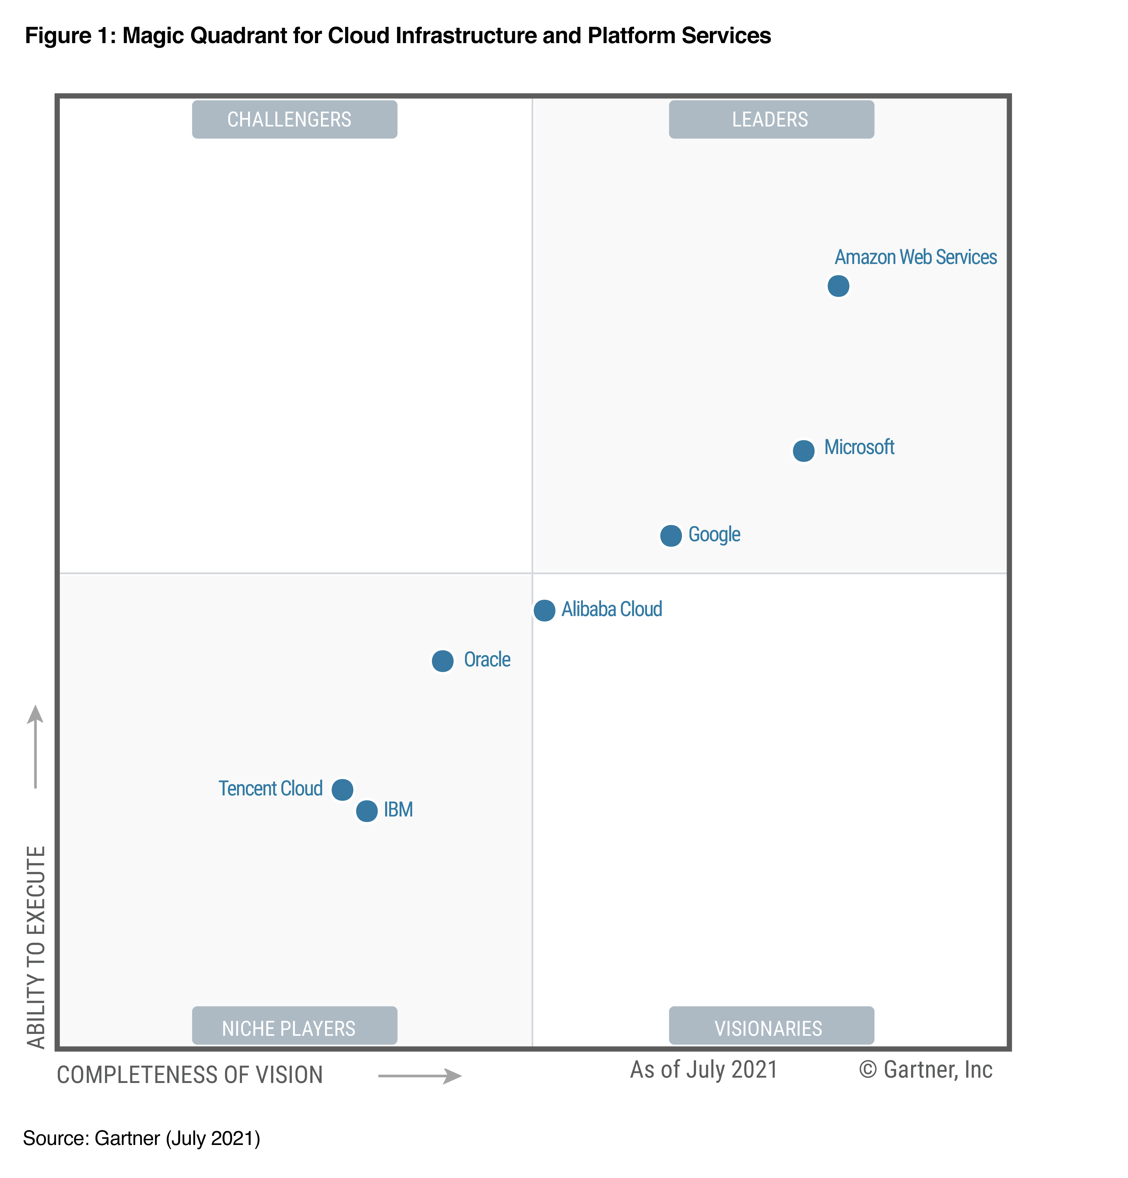
IaaS Players

Slide 73
Cloud Models
Public
Private
Hybrid
Community

Slide 74
Public Cloud
A vendor offers up their computing environment to any one (the public) to use.

Slide 75
Private Cloud
An internal-to-the-organization computing environment that can be used by the organization and their customers. Similar to a traditional IT organization but usually with some automation.

Slide 76
Hybrid Cloud
A mix of 2 or more cloud types.
Ex: private cloud for most uses but on demand spikes to a public cloud vendor
Or public cloud for public facing web app, private cloud for sensitive internal research

Slide 77
Community Cloud
Infrastructure is provided by an affinity group, different pieces owned by different organizations/people but for ”the common good.”
Ex: Gaming network
Gaming Co maintains IAM, companies/individuals maintain gaming servers, end users processing on their systems

Slide 78
Community Cloud
Ex: A college conference
The conference made up of a number of schools pool their resources to build a “cloud” environment
Economy of scale

Slide 79
Community Cloud
* I think this is a stretch but CCSP (and CISSP) books talk about it so it’s wise to know it is there.
In most environments all you’ll deal with is public, private, and hybrid.

Slide 80
Benefits of the Cloud
Reducing capital expenses
Reducing personal costs
Reducing operational costs
Transferring (some) regulatory costs

Slide 81
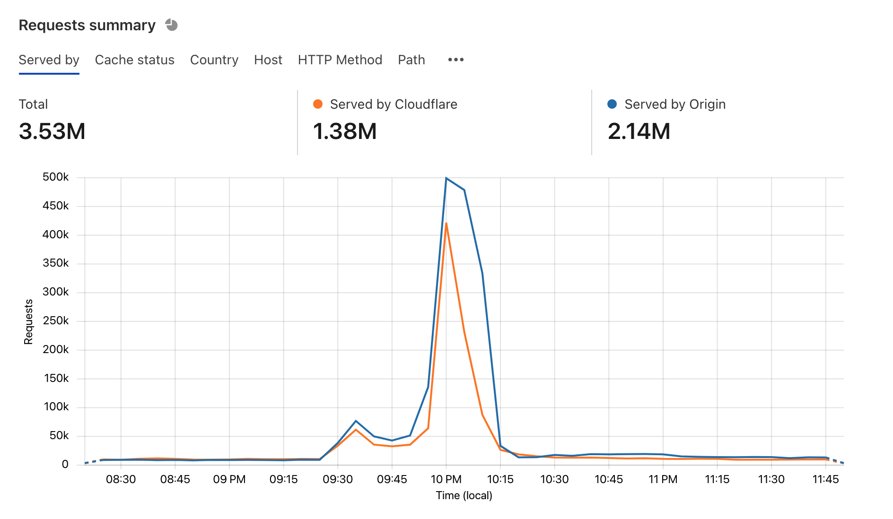
Reducing capital expenses
No need to purchase systems, network gear, racks, buildings, etc. to cover your peak usage (that may only happen once a year for a few days and the rest of the time is idle)

Slide 82
Reducing personal costs
Less on-prem systems = less IT people needed on-prem *
* IN THEORY

Slide 83
Reducing operational costs
Costs are lumped in with the flat-rate cost of the cloud contract so no longer have to plan for unexpected costs related to:
Scheduled updates
Emergency response
…

Slide 84
Transferring (some) regulatory costs
Cloud provider may offer services/systems that meet regulatory compliance (PCI, FedRAMP, etc)
Provider has set of controls that offer a turn key solution to your cloud environment.
Risk/liability is still not transferred, you’re still on the hook for PII breaches

Slide 85
Remember
If there is a breach of your cloud environment and PII is disclosed your company is the one that will be getting the bad PR, not the cloud provider.

Slide 86
Core Concepts of Cloud
Virtualization
Sensitive Data
Encryption
Auditing and Compliance

Slide 87
Virtualization
Virtualization is what makes the cloud work and makes it economically viable.
It allows providers to deploy physical systems and allow customers to use part of them (virtually) without an extended spin up/down process.
To the user there is no difference between a physical and a virtual system.

Slide 88
Virtualization
To the provider a VM is just a file, multiple VMs can run on a physical server and they are isolated from one another.
Many different options here – VMWare, Hyper V (Azure), KVM (AWS), Zen (AWS)

Slide 89
Sensitive Data
Every organization has their own risk tolerance and desires confidentiality.
Cloud provider should offer options to allow customer to categorize their data by sensitivity and provide controls to protect said data.

Slide 90
Encryption
Offers customers some assurance that only properly authorized people can access their data. This can be visible or invisible to the user (if invisible noted in a contract or SOC-II report.)
This applies to data at rest and data in transit.
This is still often left to the customer to perform.

Slide 91
Auditing and Compliance
Allowing the customer to log every action in their environment so they can audit their use and access to data is key.
Going to a provider’s physical location for an audit is pretty much impossible. Industry standard methods to demonstration compliance by the provider (ex SOC-II Type 2 or SOC-III reports) are needed here.

Slide 92
Auditing and Compliance
Complying with regulatory requirements (PCI DSS, GLBA, HIPAA, etc) is really hard. Providers who can offer a solution to compliance requirements in an easy to use method with a tested control set and procedures will be very popular.

Slide 93
Homework #1
Create an AWS account
Setup up the AWS CLI tool and configure it to be used with your AWS account

Slide 94
Reminder
I do not have any open TA/GA/grader/student employee positions at this time.
If and when I do they will be posted on MAGE’s website and/or I will post about them in ELMS.

